Slide 1


HABIT TRACKER
- J BHARGAV(1602-20-737-068)
- NANDANI(1602-20-737-118)
- AKASH((1602-20-737-105)

Slide 2
Abstract
This is a Habit Tracker with Graphical User Interface. This can be used by anyone who would like to improve their life.
The user must register himself and verify with his email account.
The user’s streak on the habit will be incremented by 1 if the habit is done, which will motivate the user and is a reward for completing the habit.
The steaks can be viewed by clicking a button present on the screen, which will reveal the steaks for all the habits.

Slide 3
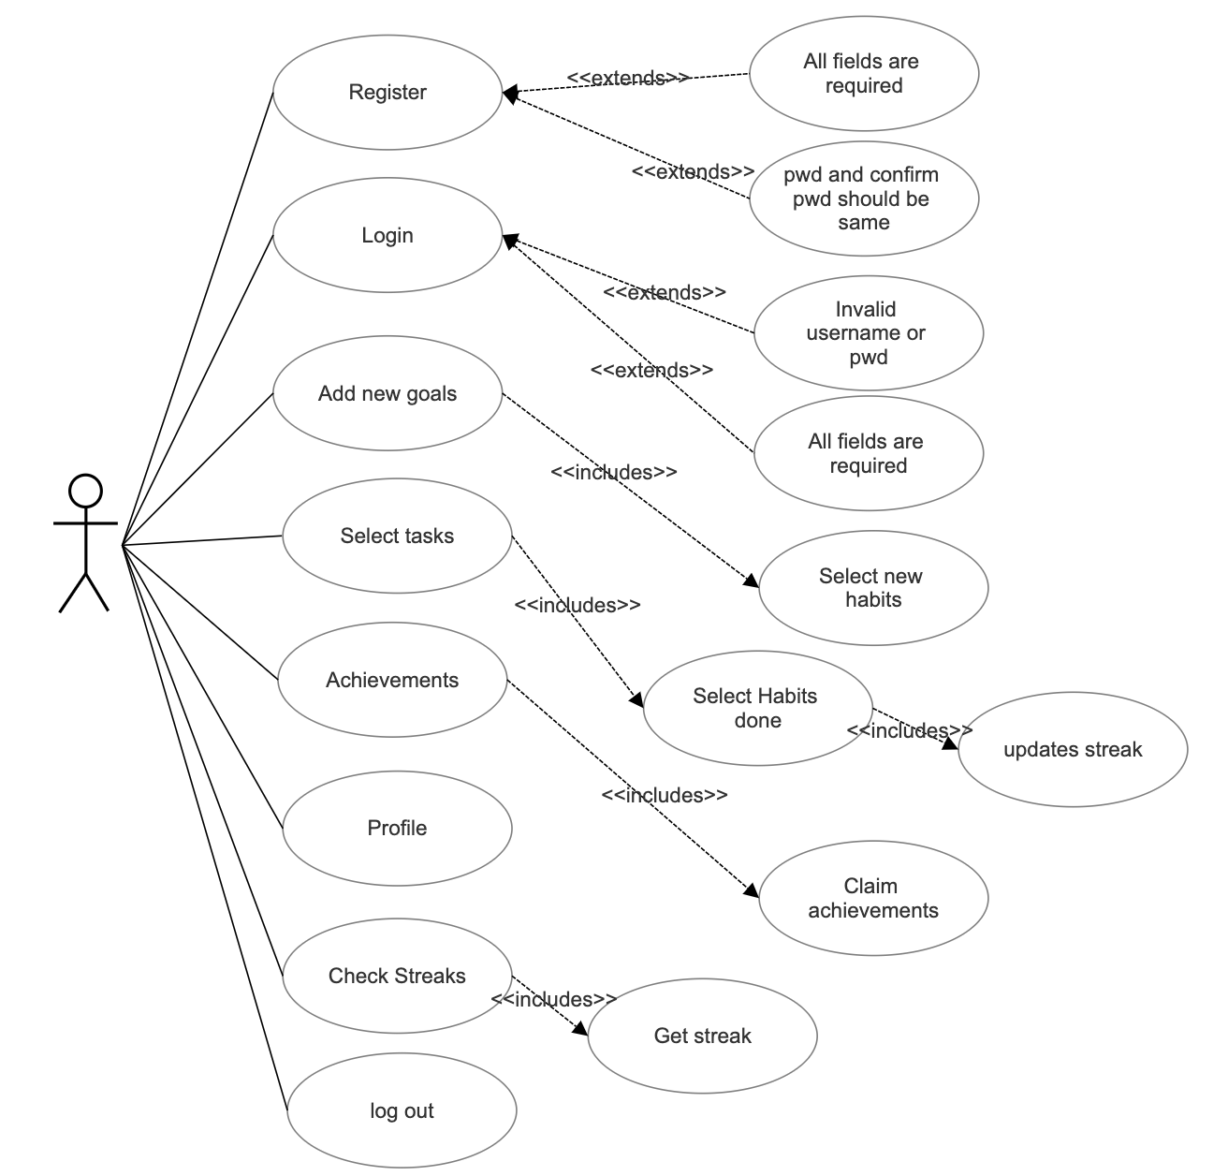
Use Case Diagram:

Slide 4
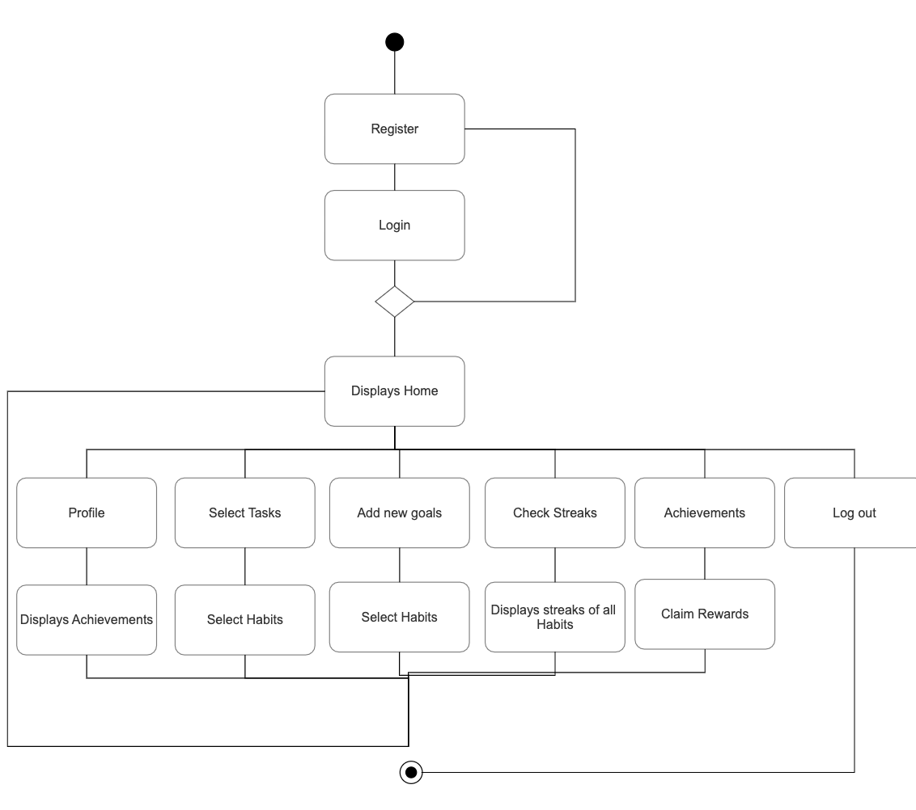
Activity Diagram

Slide 5
Technology used
Programming languages: Python
GUI: Tkinter or Tk interface is Python's de-facto standard GUI (Graphical User Interface) package
IDE: IDLE shell 3.10.1,jupyter notebook
Databases/Data storages: SQLite

Slide 6
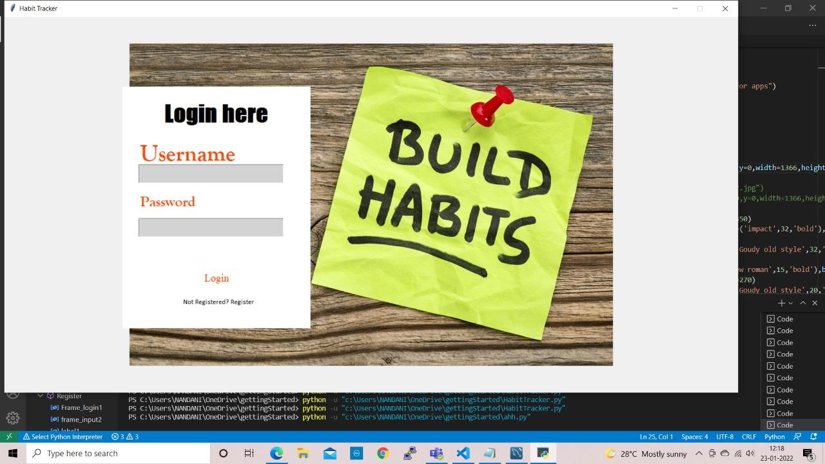
Screenshots of the execution

Slide 7
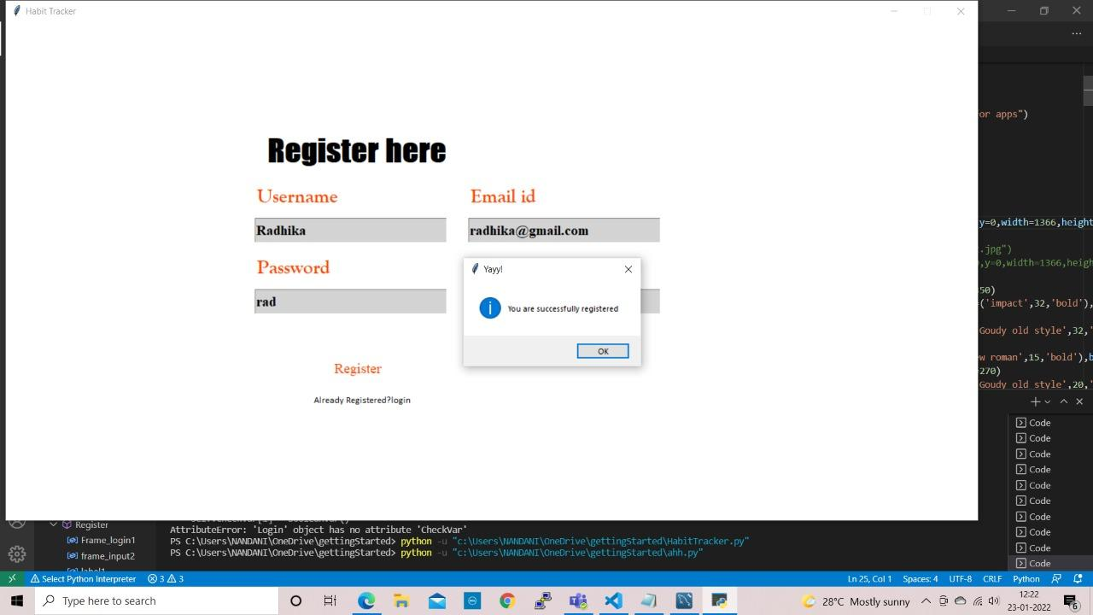

Slide 8
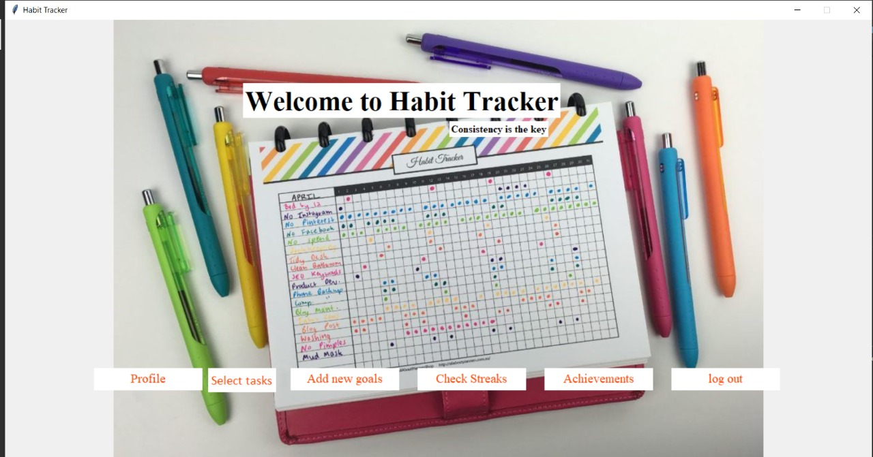

Slide 9
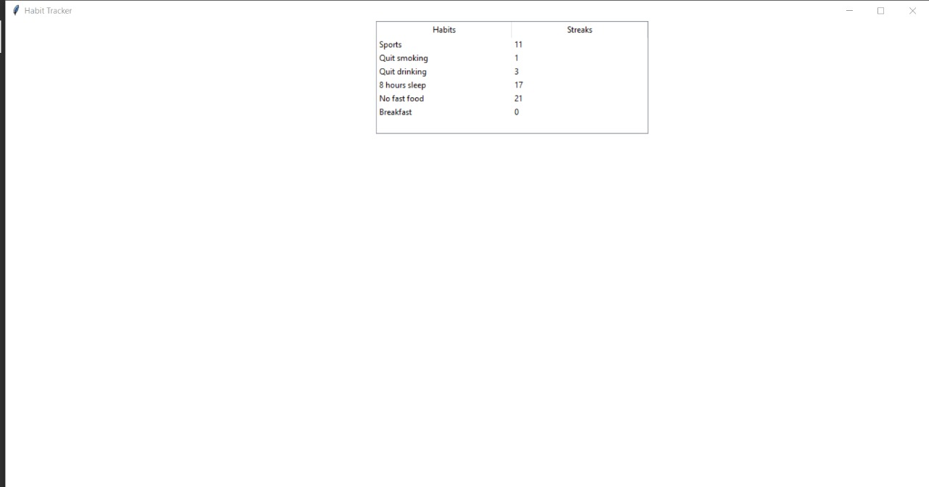
(Check streaks is clicked) Before adding new Habit

Slide 10
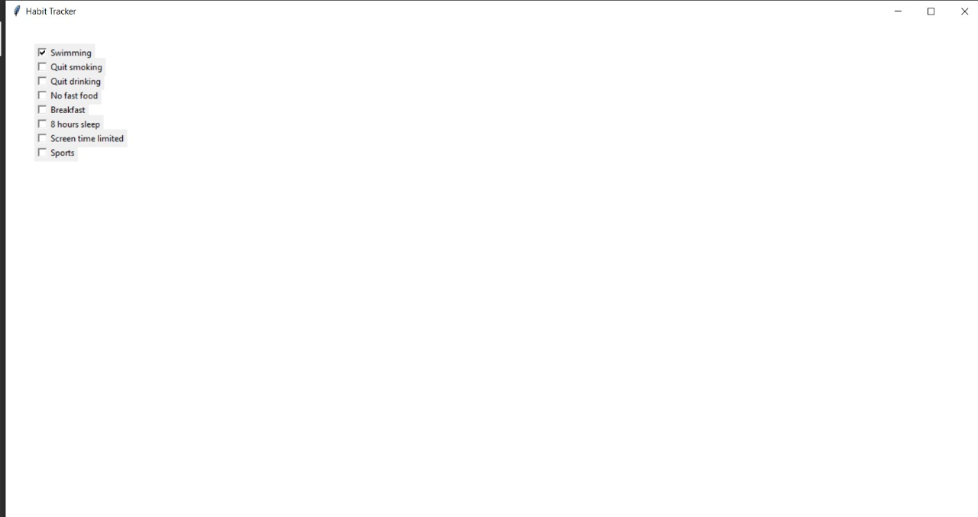
(Add new goals clicked) Swimming is selected

Slide 11
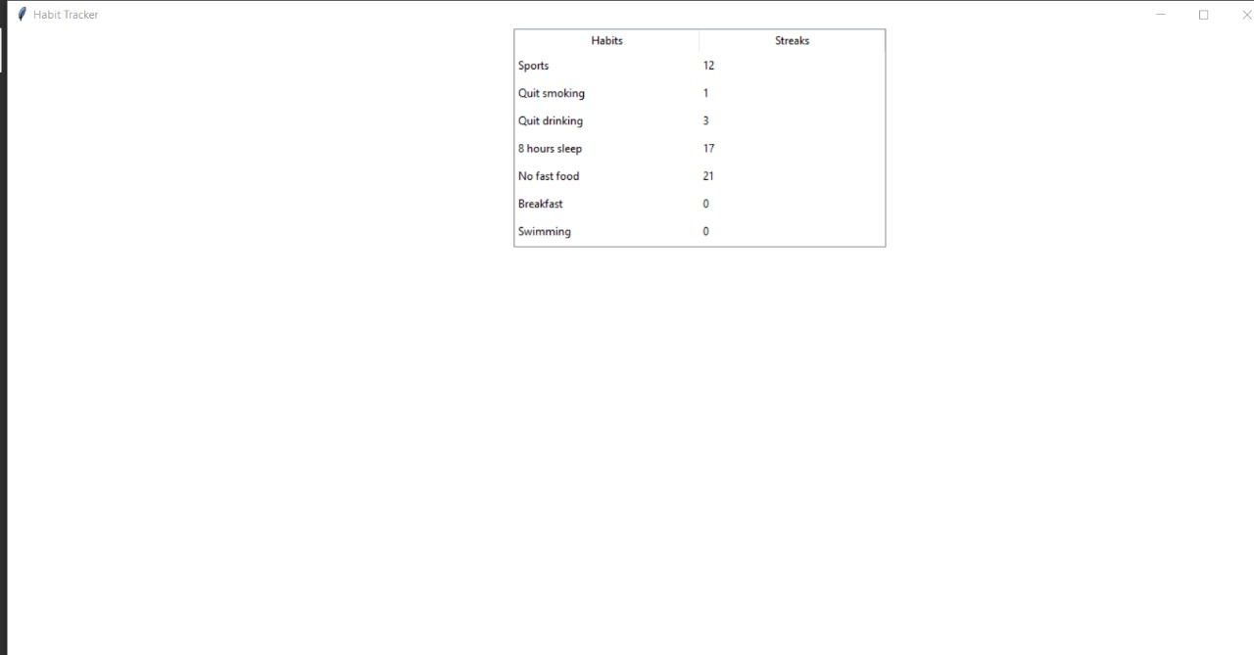
(Check streaks is clicked) Now Swimming is also added in the list of habits

Slide 12
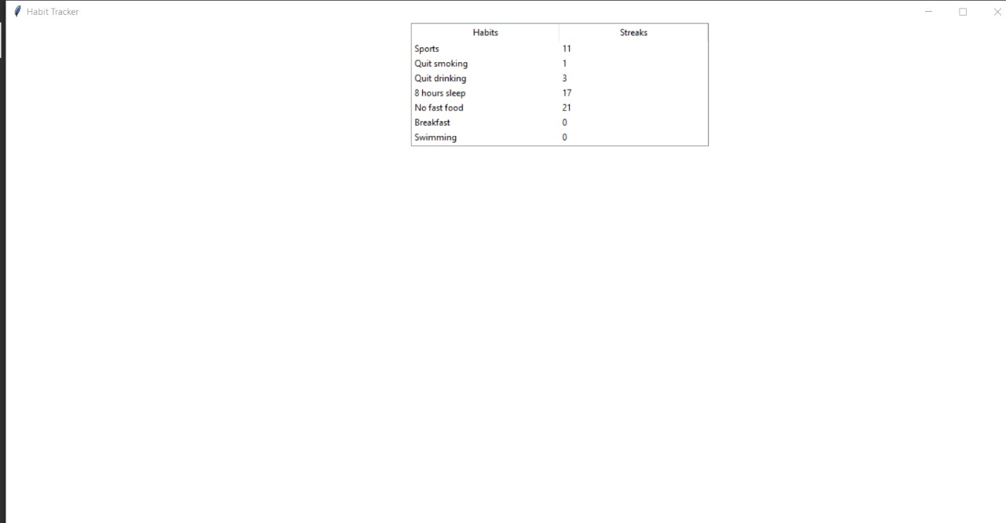
(Inside Check streaks) Streaks before performing a habit

Slide 13
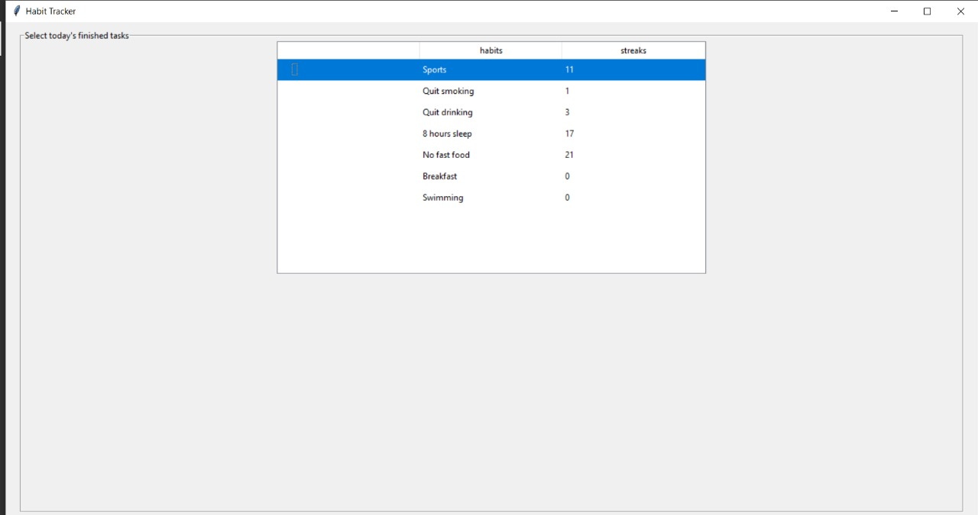
(Inside Select tasks) Selects Sports

Slide 14
(Inside Check streaks) The streaks for Sports increased from 11 to 12

Slide 15
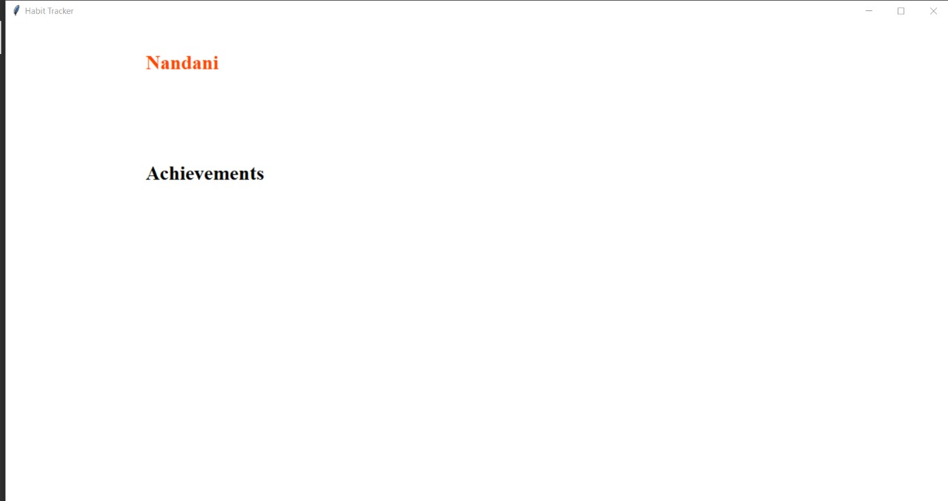
(Profile) This is the profile page of user before Claiming crowns

Slide 16
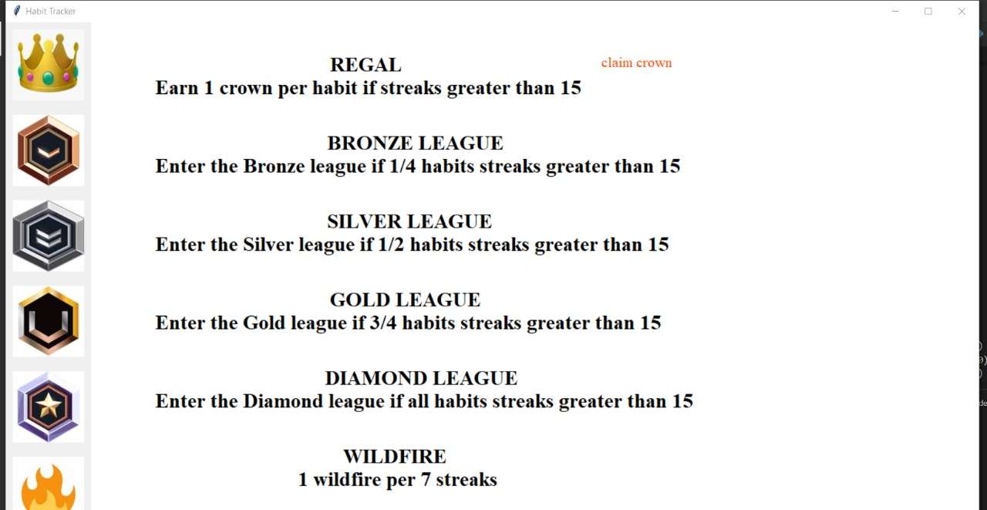
(Inside Achievements) Claim crowns is clicked

Slide 17
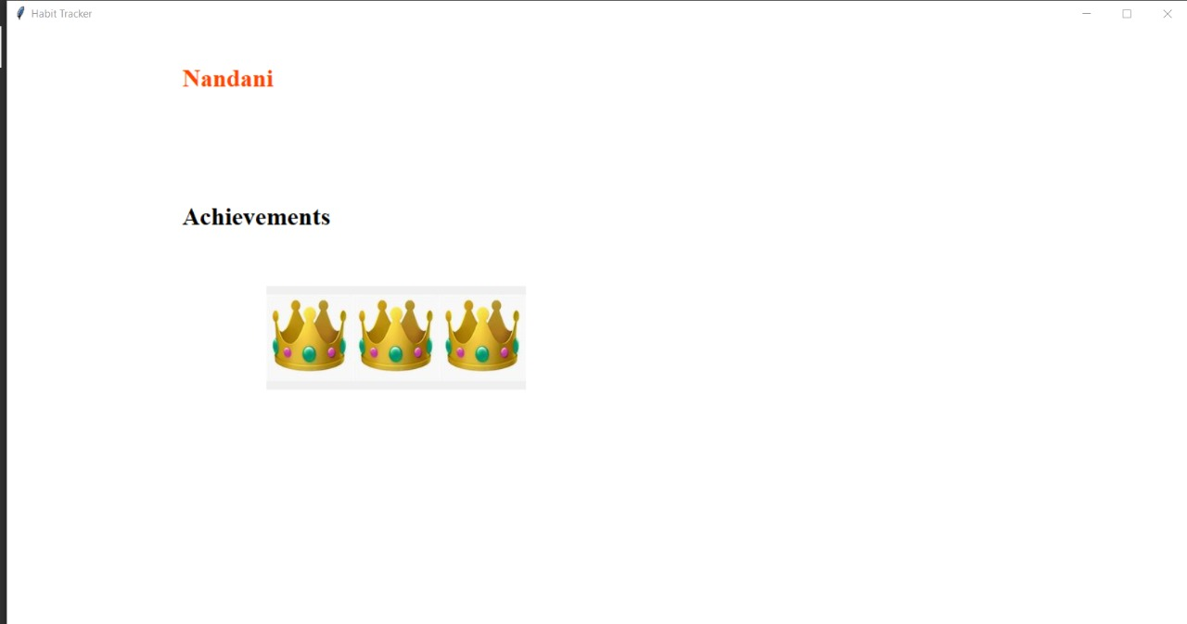
(Inside Profile) The Profile is updated with 3 crowns since the user has 3 Habits with above 15 streaks.

Slide 18
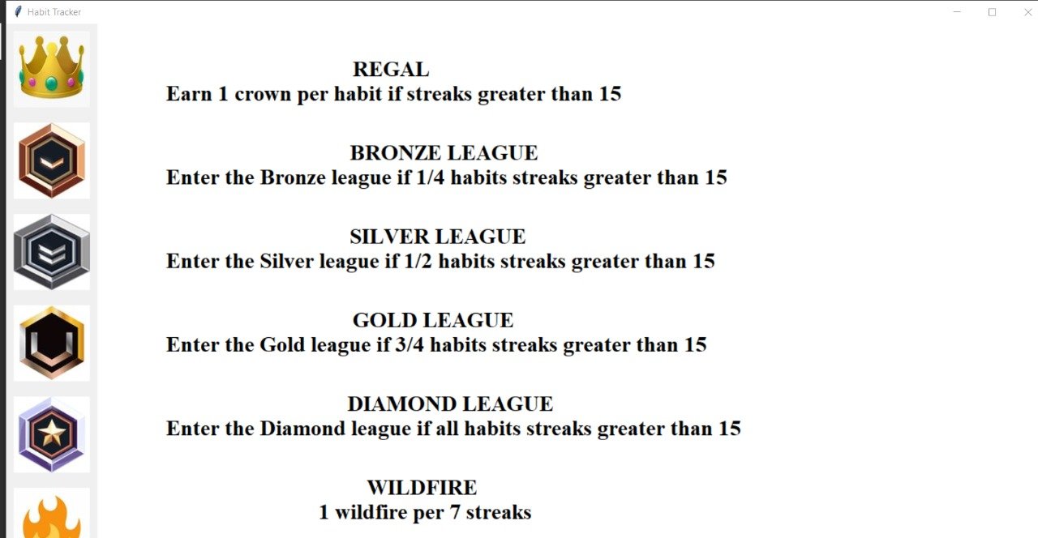
(Inside Achievements) Claim crowns option not available once clicked and awarded

Slide 19
Conclusion and Future scope
Conclusion
Habit Tracker is a simple but useful application that is used to keep track of habits. It is a code that provides a lots of value and is helpful.
Future scope
The user can connect through his Facebook account and play contests with his friends.
Make it a web application rather than a console one.
Improve the GUI and include the photos of teams and players while the user bets.

